Slide 1
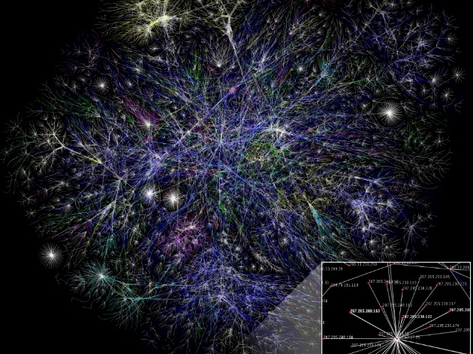
Dynamic Optical Networking
Chapters 8: J. M. Simmons,
Optical Network Design and Planning, Optical Networks,
© Springer International Publishing 2014

Slide 2
Introduction
Transport optical networks today are typically quasi-static, with connections often remaining established for months or years.
As an initial transition from this relatively fixed environment, transport optical networks are becoming configurable.
The connections are established remotely through software control.
This eliminates the time and cost involved with sending personnel to sites along the new path.
Configurable networks take advantage of network elements → reconfigurable optical add/drop multiplexers (ROADMs). which can be remotely reconfigured to add, drop, or bypass any wavelength.
The next step in this evolution is dynamic networking. where connections can be rapidly established and torn down without the involvement of operations personnel.
It is envisioned that the need for dynamic services will burgeon over the next 5–10 years.
1

Slide 3
Introduction, cont’d
Networks are generally composed of a data plane, a management plane, and a control plane .
The data plane is directly responsible for the forwarding of packets and bit streams.
The management and control planes are responsible for network operations.
Historically, optical network configuration has been performed via a centralized network management system (NMS).
However, with dynamic optical networking, this function is accomplished via the control plane.
2

Slide 4
Motivation for Dynamic Optical Networking
Dynamic networking is advantageous for both network carriers and their customers because it delivers bandwidth where and when it is needed.
From the
carrier
Perspective have two major benefits
it allows the carrier to adapt its network to sudden changes in network traffic.
sudden flux of traffic occurs, Rapidly adding more capacity to the stressed portion of the network
2. it can also be used as a proactive sales tool to derive more value from the network. Once a dynamic infrastructure is in place, a variety of network services become viable, which adds to the revenue opportunities for the carrier.
3

Slide 5
Applications Enabled by a Dynamic Optical Network
Once a dynamic infrastructure is in place, it is natural to offer customers bandwidth on-demand services.
Dynamic optical networks can also be promoted as an enabler of high-performance cloud computing .
Another related application is grid computing . which is used as a means of sharing distributed processing and data resources that are not under centralized control.
Dynamic networking is an attractive alternative, where the connection setup time must be on the order of 100 ms .
Another application that becomes feasible with very fast service setup is “route
hopping” for purposes of security, where a connection is rapidly moved to a new
path to avoid eavesdropping.
4

Slide 6
Centralized Path Computation and Resource Allocation
To implement dynamic optical networking:
Knowledge of system parameters, network topology, current state of network resources.
Path computation.
Control of the network elements.
first consider a centralized model, where the path computation and resource allocation functions are performed at a single location in the network.
define a Path Computation Element (PCE)-based architecture, where the PCE is a powerful computing platform that is capable of performing constraint-based routing .
In the centralized model, the PCE is located at a single node or server, and all routing requests are directed to it.
5

Slide 7
PCE-Based Operation
In the centralized single-PCE architecture, it is assumed that the PCE can have
full visibility into the state of the network.
System parameters, such as optical reach or line rate, are likely to change very infrequently, if at all, and thus can be manually configured on the PCE.
The physical network topology may change, as links fail and are repaired. The PCE can track the
current network topology by routing protocol such as Open Shortest Path First (OSPF)
6

Slide 8
8.3.1
PCE-Based Operation
A new demand request is received by the source node.
The source node sends a path request to the PCE.
The PCE Communication Protocol (PCEP) is used for all communication between the PCC and PCE.
After receiving the request, the PCE performs the necessary routing calculations and
resource assignments and returns the result (assuming one can be found) to the source node.
The source node then uses a signaling protocol to communicate with the nodes along the resultant path
to establish the new connection (i.e., the lasers are tuned and the ROADMs are configured, as calculated
by the PCE).
Path Computation Request
PCE
2
Path Computation Response
Demand request
3
A
B
C
D
E
1
Source
Destination
Signaling to establish connection
7
4

Slide 9
Advantages of Centralized Operation
The biggest advantage of centralizing all path computation and resource allocation
in one entity is the potential for optimality.
By having full knowledge of the network state, the PCE can calculate the “best” path, regeneration locations, and wavelength(s) for a new connection.
A second advantage of this model is the ability to avoid resource contention during the connection setup.
Because the PCE can track all wavelengths that have previously been assigned, it can avoid assigning the same wavelength to multiple connections routed on the same fiber.
The third advantage to centralizing the computation is that the processing and memory resources are deployed in one element as opposed to being required at multiple network sites. Depending on the complexity of the network design algorithms, the processing requirements can be significant.
8

Slide 10
Disdvantages of Centralized Operation
In your opinion if we have a global network with one PCE located in the USA, a demand request between two cities in Europe with need to be directed to this PCE, what happen ?
1. delay between the source node and the PCE
computation time at the PCE and the time to configure the equipment (e.g., lasers,
ROADMs)
bulk of the delay is due to
propagation, which is dictated by the speed of light in fiber, system enhancements,
such as having a more powerful PCE, do not solve the problem.
connection setup time
includes the round-trip propagation delay
+
2. the propagation delay from the source
to the destination
9

Slide 11
Multiple PCEs
A logical alternative is to deploy multiple PCEs throughout the network.
such that the propagation delay from any network node to a PCE is below a certain threshold.
This potentially reduces the setup time by tens of milliseconds, depending on the geographic extent of the network.
It is assumed that each of the PCEs has visibility into the whole network.
Thus, each PCE is capable of calculating an end-to-end path without having to communicate with other PCEs.
Even though a PCE can communicate the results of all of its path computations to the other PCEs (via PCEP), there will be a delay in propagating the information . Thus, for some amount of time, the other PCEs will be unaware.
A particular wavelength on a link has already been assigned. Another PCE may select that same wavelength for one of its demand requests, thereby causing contention.
To summarize, a centralized single-PCE-based solution is likely satisfactory if the setup time requirements are on the order of 1 s or more, but is not adequate if the requirements are on the order of 100 ms. A quasi-centralized multi-PCE solution may meet the timing requirements in the latter scenario, but it introduces other drawbacks, most importantly, contention.
10

Slide 12
Distributed Path Computation and Resource Allocation
This section discusses a purely distributed approach.
use : Generalized Multi-Protocol Label Switching (GMPLS) architecture
use : Resource ReserVation Protocol-Traffic Engineering (RSVP-TE) signaling
protocol
Assumptions:
operation that is presented here should be considered just one variation
we describe the setup of a unidirectional path from one source to one destination
Regeneration is not required due to optical reach constraints
It is assumed that regeneration may occur for purposes of wavelength conversion
11

Slide 13
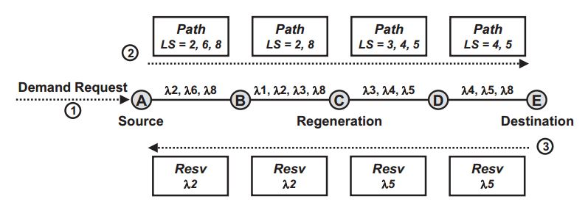
GMPLS-Based Operation
Once the path is computed by the source node, a two-pass signaling process is initiated
The wavelengths that are assumed to be available on each link are shown in the figure
Using RSVP-TE signaling, the source transmits a Path message along the route that it just calculated
An important field in this message is the Label Set , which is initialized to a list of wavelengths that are available on the outgoing link from the source node.
This process continues at each node in the path, such that at any node, the Label Set indicates a set of
wavelengths that are free along each of the links from the source node to that node.
12

Slide 14
GMPLS-Based Operation, cont’d
If none of the wavelengths in the Label Set are free on the outgoing link of a node, then regeneration must occur for purposes of wavelength conversion.
Assuming that the Path message is successfully received at the destination.
Resv message is sent in response.
The destination selects one of the wavelengths from the Label Set, and includes that wavelength in the Resv message
The Resv message is received at the source node. After the equipment at the source node is configured, transmission can begin.
13

Slide 15
Advantages of Decentralized Operation
The most important advantage of the distributed approach is that the setup time is
potentially very fast.
There are generally two options regarding switch configuration in the reservation phase:
the methodology employed has a significant impact on setup delay.
RSVP-TE specifies that a node should configure its switch prior to forwarding the Resv message to the upstream node.
14

Slide 16
Disadvantages of Decentralized Operation
Among the disadvantages of the distributed scheme are the need for potentially powerful processing resources at each of the nodes, and the loss of optimality in performing route calculations.
The most significant drawback is the amount of resource contention that can potentially occur.
Some amount of time transpires between the arrival of the Pathmessage and the arrival of the Resvmessage at any given node.
During that time, wavelengths that had been available may have been assigned to other connections.
Thus, by the time the Resvmessage is received at an intermediate node, the wavelength selected by the destination may no longer be available. This is called backward blocking because it occurs in the backward direction.
When it occurs, the Resvmessage is dropped, a failure message is sent both to the source and the destination, and any successful reservations that already occurred for this connection are released.
15

Slide 17
Schemes to Minimize Contention
Backward blocking occurs because of the delay between the probing message and the reservation message.
The difficulty is in selecting which wavelength to reserve.
A different approach to deal with contention was proposed in the 3-Way Handshake(3WHS) signaling protocol of Skoog and Neidhardt and Chiu .
The focus here is on the methodology to reduce backward blocking .
After receiving the Path message, the destination selects a wavelength from the Label Set as the primary wavelength to use for the connection.
In addition, it picks a secondary wavelength to be used in case backward blocking of the primary wavelength occurs.
16

Slide 18
Schemes to Minimize Contention, cont’d
Both wavelengths are included in the Resv message, and nodes along the path reserve and configure their switches for both of them.
The source sends a message back towards the destination indicating its choice of wavelength so that any node that also reserved the other wavelength can release it.
The source can begin transmission after its own switch is configured.
If neither the primary nor the secondary wavelength was reserved successfully, then the setup fails.
simulations on Reference Network 1 showed that by reserving a secondary wavelength,the rate of backward blocking can be significantly reduced, [SCGN12].
17

Slide 19
Combining Centralized and Distributed Path Computation and Resource Allocation
As described above, both the centralized and distributed architectures have strengths and weaknesses.
main disadvantage | major strengths
potential connection setup delay | centralized processing requirements and improved optimality of the solution | single-PCE architecture
non-optimality and the required processing at each node | minimization of delay | distributed GMPLS architecture
18

Slide 20
Combining Centralized and Distributed Path Computation and Resource Allocation
It is assumed here that a two-step approach to routing and wavelength assignment yields good performance.
Route calculation in the optical layer is characterized by high processing requirements, Thus, from a processing perspective, a PCE-based routing implementation is favored.
As compared to routing, wavelength assignment has an opposite characterization. Given the route, wavelength assignment is typically a relatively simple procedure, such that powerful processors are not required.
Thus, we conclude that in a combined centralized/distributed architecture, routing should be PCE based and wavelength assignment should be GMPLS based .
This combined GMPLS/PCE mode of operation, for the most part, takes advantage of the strengths of both architectures
19

Slide 21
Physical-Layer Impairments and Regeneration in a Dynamic Environment
Capturing the relevant physical-layer impairments and selecting the sites at which a
connection should be regenerated can be challenging even in a non-dynamic environment.
It can be more difficult in a dynamic environment where full resource state information may not be known.
Regeneration in a PCE-Based Implementation
We first consider selecting regeneration sites for a connection in the single-PCE centralized architecture
It is assumed that the PCE would be provided with the impairment information on each of the links:
OSNR, dispersion…
Then, assuming that the PCE has full knowledge of each of the wavelengths that have been allocated already on a link.
full knowledge regarding the usage of transponders at each node, the PCE should be able to calculate the proper sites at which to regenerate a connection.
The result of the regeneration calculations would be sent back to the source node.
20

Slide 22
The source node would then include this information in the signaling message that actually establishes the new path.
For example, the source node would need to issue an order that an intermediate node interconnect transponders Aand B and configure its ROADM such that the incoming path is received on transponder A on wavelength i and the outgoing path is transmitted on transponder B on wavelength j.
Problem : a PCE may calculate that a regeneration occur at a particular node along the path, using a particular pair of transponders. However, another PCE, handling a simultaneous request, may have already allocated these transponders, thereby resulting in contention.
If one PCE were to calculate the regeneration sites for a new 40 G connection without knowledge that another PCE was simultaneously establishing a new 10 G connection on an adjacent wavelength, the 40 G connection may not have satisfactory performance.
21

Slide 23
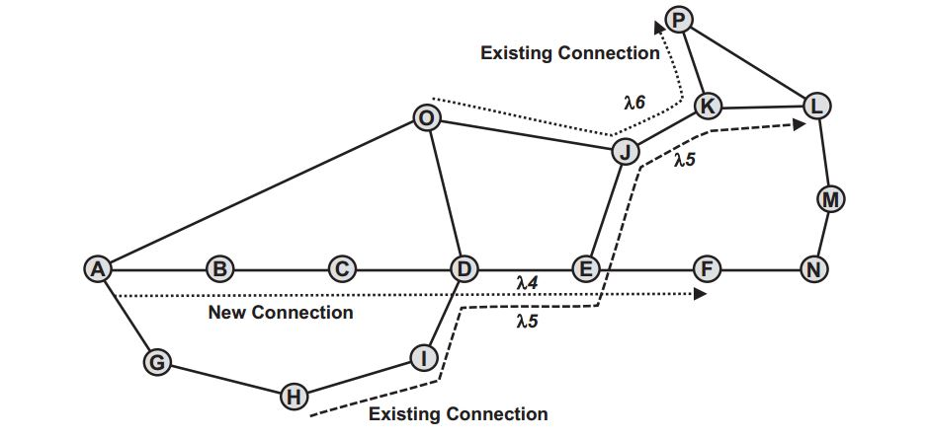
Regeneration in a GMPLS-Based Implementation
Regeneration could also be determined as part of the distributed signaling protocol , e.g., GMPLS .
22
Notes:
consider the setup of path A-B-C-D-E-F
Assume that one regeneration is required along this path, and that it can occur at Node B, C, or D.
If regeneration calculations are performed node-by-node, then the “furthest” node would typically
be selected as the regeneration site, i.e., Node D
However, Node D may have few available transponders, making it a poor choice for regeneration.
Or, it may have no free transponders, making it an invalid choice for regeneration.
Nodes B and C would not have knowledge of this, unless this detailed resource
information were to be disseminated network-wide.

Slide 24
23
Notes:
from Node A to Node F, is A-B-C-D-E-F. Assume that the wavelength selected on link DE is λ4
. Also, assume that there is an existing connection, from Node H to Node L, routed on link DE, which has been assigned to λ5
.
To perform this QoT calculation, Node F would need to have the full routing details of the HL connection,
plus the information regarding any neighboring wavelengths of the HL connection (e.g., it would need to know that a connection has been
assigned to λ6on Link JK).
Essentially, information regarding each wavelength on each link in the network would need to be disseminated to all nodes

Slide 25
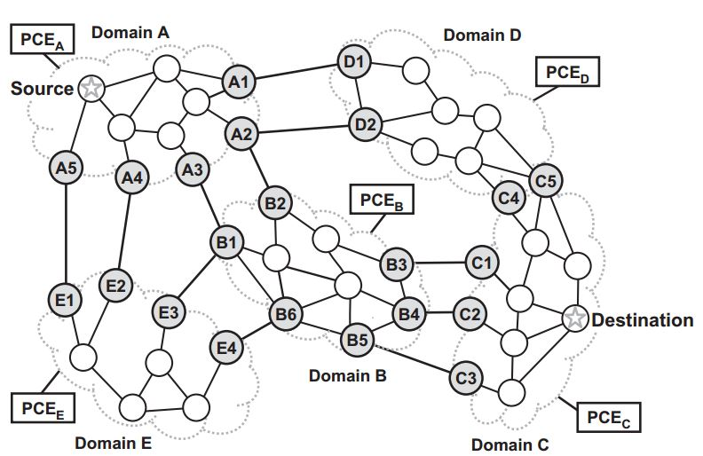
Multi-Domain Dynamic Networking
shaded nodes represent boundary nodes(BNs),
The others : interior
24
Notes:
It includes five domains, labeled A through E //
The shaded nodes represent boundary nodes(BNs), which lie on either end of an inter-domain link (e.g., Nodes A1 and D1) //
or which lie at the boundary of two domains (e.g., Node C4).
One PCE per domain is shown //
Assume that a demand request arrives at the source node shown in Domain A //

Slide 26
There are two major components of multi-domain routing.
The first is selecting the sequence of domains that should be traversed from source node to destination node.
the second is determining the actual path through each of the domains.
we outline two particular multi-domain routing strategies that have been introduced in the IETF:
Backward-Recursive PCE-Based Computation (BRPC)
Hierarchical PCEs.
25

Slide 27
Backward-Recursive PCE-Based Computation
BRPC
In BRPC, the sequence of domains to follow between the source node and destination node is assumed to be known.
26
Notes:
the domain sequence to be used by BRPC is A-B-C. The demand request will be forwarded from PCEA to PCEB to PCEC
.

Slide 28
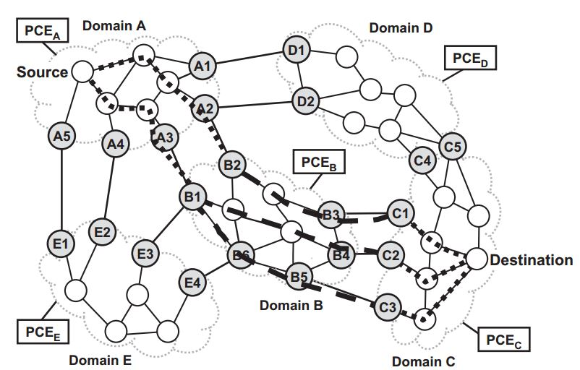
PCEC initiates the routing process by calculating a tree from its set of BNs that border Domain B (i.e., C1, C2, and C3) to the destination node.
27

Slide 29
PCE(C) has full knowledge of Domain C, and thus is able to calculate the optimal path for each of the three branches of this tree, where “optimal” is with respect to whatever metric was specified in the demand request.
The tree that is calculated is referred to as the Virtual Shortest Path Tree(VSPT).
PCE(C) calculates the total cost of each branch of the tree and passes this information to PCE(B).
PCE(B) proceeds to calculate the optimal paths from its BNs that border Domain A (i.e., B1 and B2) to the destination node, using the VSPT cost information provided by PCE(c) combined with its own detailed knowledge of Domain B.
Thus, the tree branches now extend from B1 and B2 to the destination node.
PCE(B) forwards the total cost of each branch to PCE(A) . (It is necessary to forward the information of only the lower cost of the two paths that extend from B1 to the destination node.)
Combining the costs of these tree branches with the cost information forwarded by PCE(B) , PCE(A) can then determine the minimum-cost path from source node to destination node, given the domain sequence A-B-C.
28

Slide 30
Hierarchical PCEs
One drawback to BRPC is that it does not include an explicit mechanism for determining the sequence of domains to be followed from source node to destination node.
In contrast, the Hierarchical PCE scheme both determines the sequence of domains and finds a route from the source node to the destination node.
In this architecture, each PCE associated with a domain is considered a child PCE.
There is an additional PCE, known as the parent PCE (pPCE), which can communicate with each of the children PCEs.
The pPCE has knowledge of how the domains are interconnected, including knowledge of any inter-domain links, but does not have visibility into any of the domains themselves.
from the point of view of the pPCE:
29

Slide 31
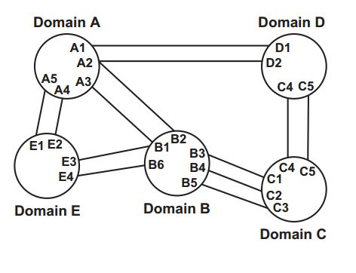
Abstract topology :as seen by the parent PCE. Each of the nodes represents a domain, with the links being the inter-domain links. “Dummy” inter-domain links are added between Domains C and D,
where Nodes C4and C5lie in both
domains.
30

Slide 32
When an inter-domain route is requested, the request is forwarded to the pPCE.
The pPCE runs a routing algorithm on its abstracted topology to determine several candidate domain sequences.
Three candidate sequences:
31

Slide 33
The pPCE generally selects the candidate sequences based on the traffic engineering properties of the inter-domain links.
The pPCE then requests that each of the domains that appear in a candidate sequence provide cost information for their portion of the desired path.
For example, for the first domain sequence, the pPCE requests cost information from: PCEA, for the path from the source node to A2; PCEB, for the path from B2 to B4; and PCEC, for the path between C2 and the destination node.
After collecting all of the cost information, and adding in the costs of the inter-domain links, the pPCE determines the solution that produces the least-cost path.
32

Slide 34
Note that the path produced by this method is not necessarily optimal, due to the pPCE relying on only its knowledge of the inter-domain links to select the candidate domain sequences.
First, the set of candidate domain sequences that are selected may not contain the optimal sequence.
Second, the inter-domain links that the pPCE selects to use for a particular domain sequence may not be optimal.
For example, selecting B5-C3 as the link between Domains B and C, as opposed to B4-C2, may produce a lower cost solution.
This latter limitation could be remedied by having the pPCE request cost information for all possible paths between the entry and exit BNs of a domain; however, this may not be scalable, depending on the
number of BNs.
33

Slide 35
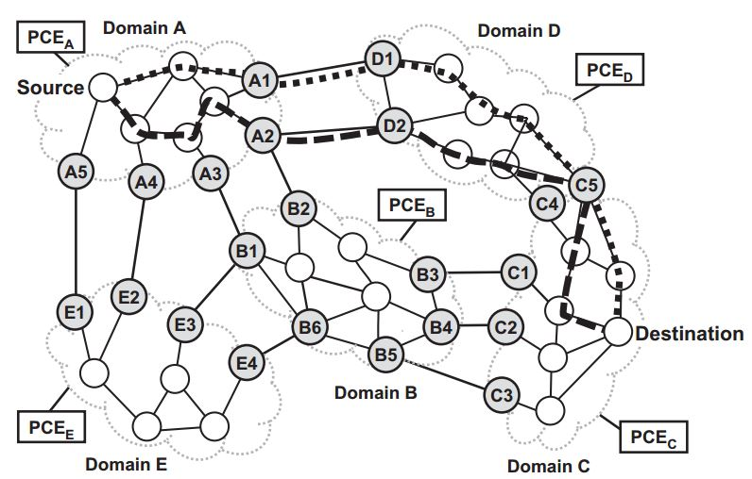
Protected Multi-Domain Connections
It may be desirable to establish diverse paths between a source node and a destination node.
There are various levels of diversity that can be enforced: link, node, and domain.
34
Notes:
Assume that the pPCE has calculated A-D-C as one of the candidate domain sequences //

Slide 36
In this scenario, the pPCE would request cost information from PCE(A) for link-diverse paths from the source node to both A1 and A2.
This is an example of where “1-to-2” diverse routing, with one source and two destinations.
Link Diversity
Finally, the pPCE would request cost information from PCEC for link-diverse paths between C5 and the destination node.
“2-to-1” diverse routing
35
Notes:
the pPCE may choose to use only boundary node C5 to transit from Domain D to Domain C. If so, it
would request cost information from PCED for link-diverse paths from D1 and D2 to C5. This is an example of “2-to-1” diverse routing. Finally, the pPCE would request cost information from PCEC for link-diverse paths between C5 and the destination node.

Slide 37
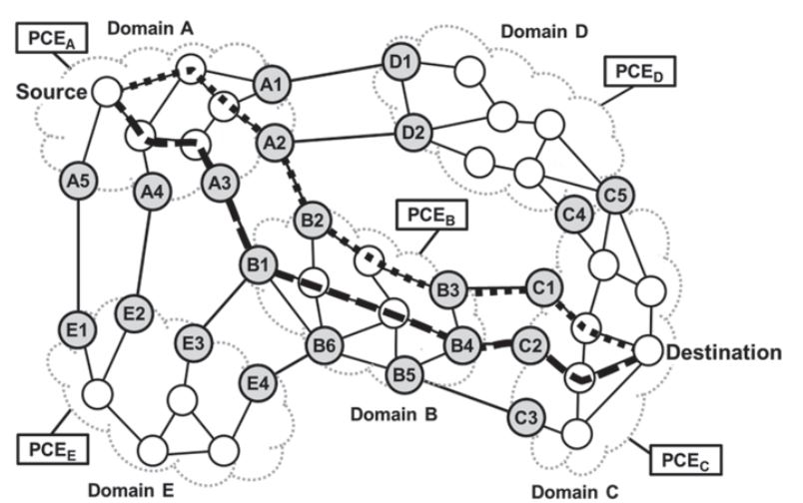
Assume that node diversity is also required.
using the domain sequence A-B-C.
Node diversity
link-and-node-diverse
“2-to-2” diverse routing
explore additional combinations of exiting BNs
36
Notes:
The pPCE requests the cost information from PCEA
for link-and-node-diverse paths from the source node to A2 and A3.
Assuming that the pPCE has selected B3 and B4 as the exiting BNs for Domain
B, it would request cost information from PCEB for link-and-node-diverse paths
from B1 and B2 to B3 and B4.
This is an example of “2-to-2” diverse routing,
also covered in Sect. 3.7.3. (It may be desirable to explore additional combinations of exiting BNs. Thus, the pPCE could also request the costing of diverse paths from B1 and B2 to, for example, B4 and B5.) Finally, the pPCE would
request information for link-and-node-diverse paths between C1 and C2 and the
destination node.

Slide 38
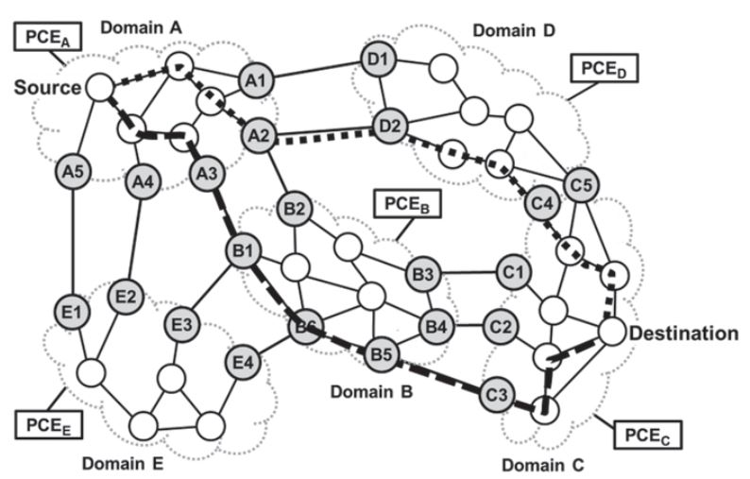
In the third scenario, domain diversity is also required
Domain diversity
1-to-2 diverse routing
2-to-1 diverse routing
unprotected routing
37
Notes:
Assume that the pPCE selects diverse domain sequences A-B-C and A-D-C, with inter-domain links A3-B1, B5-C3, and A2-D2,
and inter-domain node C4;
1-to-2 diverse routing would be utilized in
Domain A, 2-to-1 diverse routing would be utilized in Domain C, and unprotected
routing would be used in the transit domains, B and D.

